Slide 1

CAPSTONE PRESENTATION
CUSTOMER CHURN ANALYSIS
MENTOR’S NAME – MS. SHRUTI GODE
PRESENTED BY- DEEPIKA TYAGI

Slide 2
BUSINESS OBJECTIVES:
Customer churn is when customers cease their relationship with a Bank, typically by discontinuing their use of its services. Customer churn is a crucial metric impacting a Bank’s profitability and growth. Losing existing customers leads to revenue decline and incurs costs associated with acquiring new customers to replace the lost ones. High customer churn can also damage a Bank’s reputation and hinder its long-term sustainability. For deeper Analysis, our main focus will be on following points:
Analysis of the customers who has left the bank and who are still with the Bank.
Gender wise analysis of customers who left the bank and who are still with the Bank.
Region wise analysis of customers who left the bank and who are still with the Bank.
Analysis of the customer’s card category.
Analysis of the Income category of the customer who are still with the Bank as well as for those who left the Bank.
For getting to know the count of customers from the Region where highest number of customers are about to churn.

Slide 3
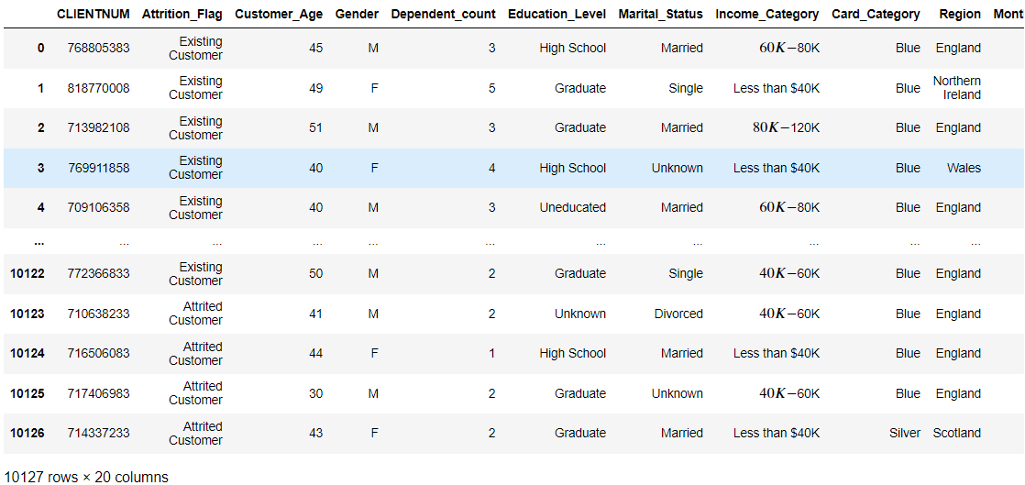

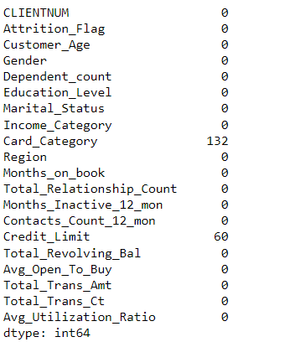
DATA PRE-PROCESSING USING PYTHON
INTERPRETATION: During Data Pre-processing using Python, firstly we have loaded the dataset in Jupyter notebook via various libraries of Python. There are 10127 rows and 20 columns in our dataset. Later on we have checked the Null value in the dataset, and we have found 2 columns with null value ,so in order to fill the null value ,we are replacing the null values with measure of central tendency as per requirement.

Slide 4
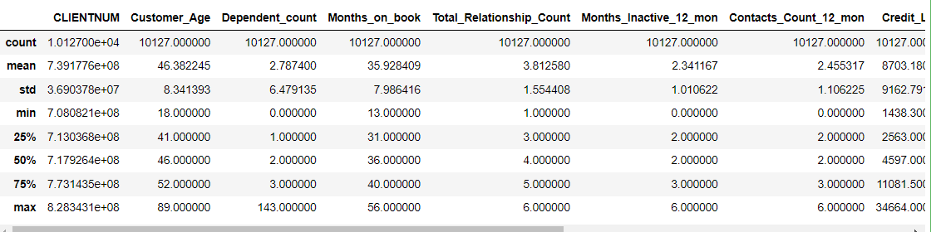
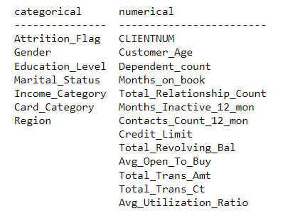
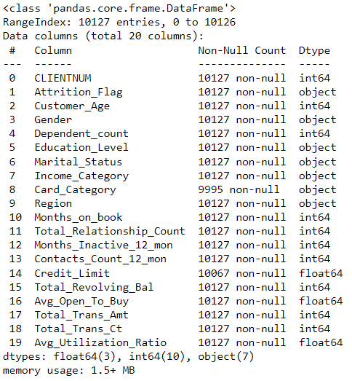
DATA PRE-PROCESSING USING PYTHON –OUTLIER ANALYSIS
INTERPRETATION: Here we have present the summary statistics of the dataset, including the separation of Categorical and Numerical columns. As we have also present here the information about dataset like as datatype etc. So by doing all the above discussed steps of Data Preprocessing, we are cleaning our dataset.

Slide 5
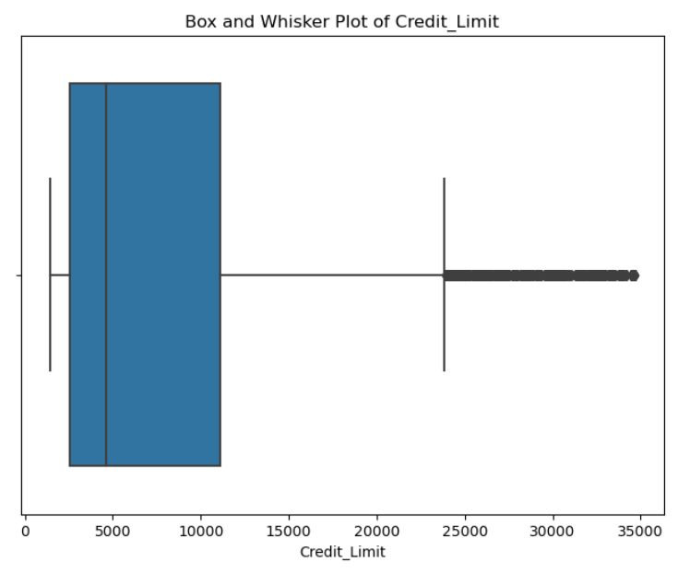
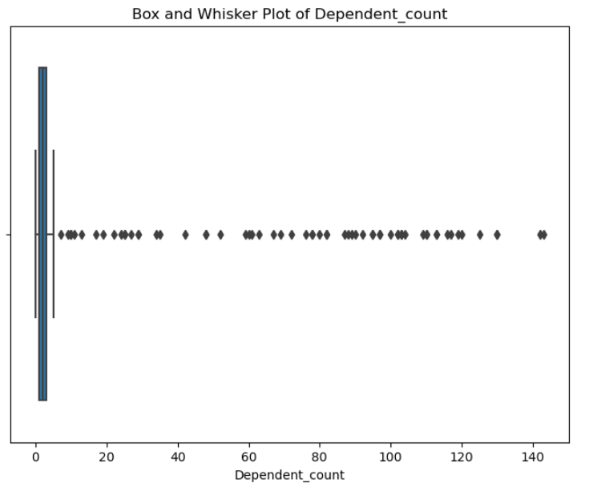
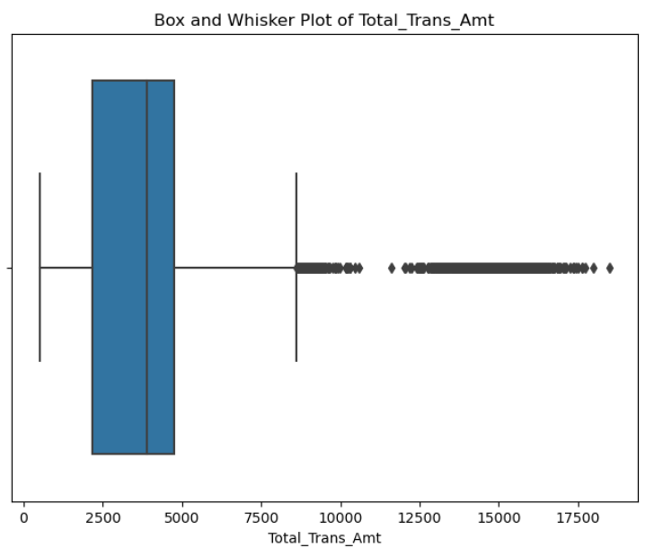
DATA PRE-PROCESSING USING PYTHON –OUTLIER ANALYSIS
INTERPRETATION: The most important step of Data Cleaning is to identify the outliers. So by using the Box Plot method ,we have found that there are so many outliers in 3 Numerical columns such as ‘Credit_limit’,’Dependent_count’ and ‘Total_trans_Amt’.
We can remove the outliers either by replacing them with ‘Mean’ or by ‘IQR’ method. This was the final step of Cleaning,so for now our Data is completely clean .So we are uploading this in ‘CSV’ file for further and deeper analysis through visualization.

Slide 6
DATA VISUALIZATION USING TABLEAU

Slide 7
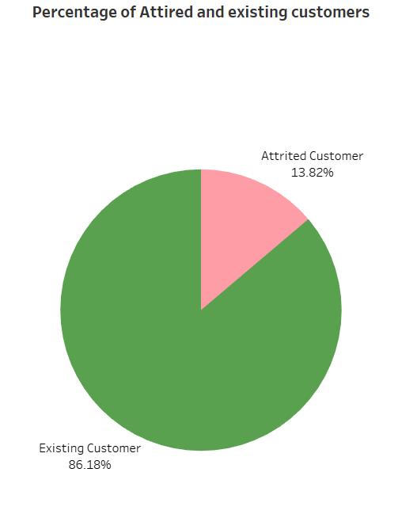
TASK-1: DISPLAY THE PERCENTAGE OF ATTIRED CUSTOMER AND EXISTING CUSTOMER FROM THE DATA.
INTERPRETATION: There is high percentage of existing customers(86%) as compared to attired customers(14%) from the Data.

Slide 8
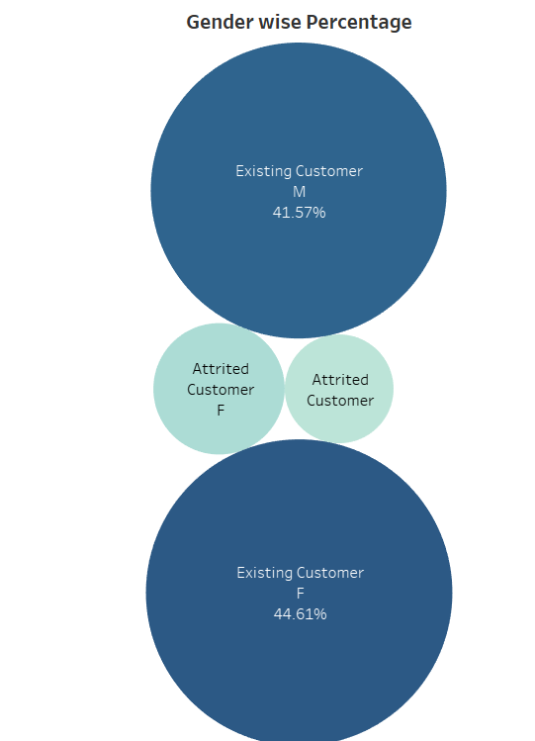
TASK-2: DISPLAY THE GENDER WISE PERCENTAGE OF ATTIRED AND EXISTING CUSTOMER FROM THE DATA.
INTERPRETATION: Female existing customers are higher 45% whether Male existing customers are only 41% .

Slide 9
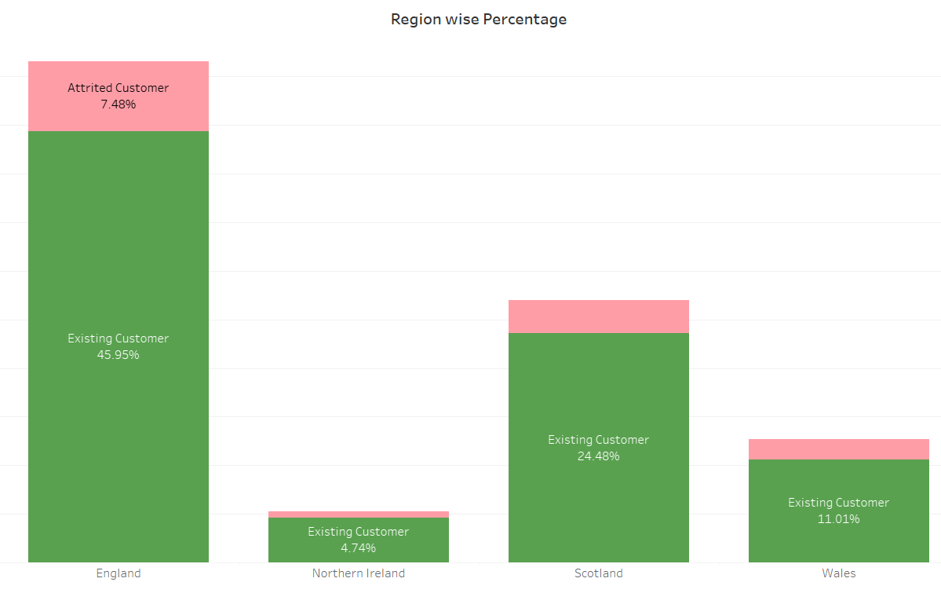
TASK-3: DISPLAY THE REGION WISE PERCENTAGE OF ATTIRED AND EXISTING CUSTOMER FROM THE DATA
INTERPRETATION:
Highest percentage of existing customers are from England Region, and after that Scotland is at second highest percentage of existing customers.

Slide 10
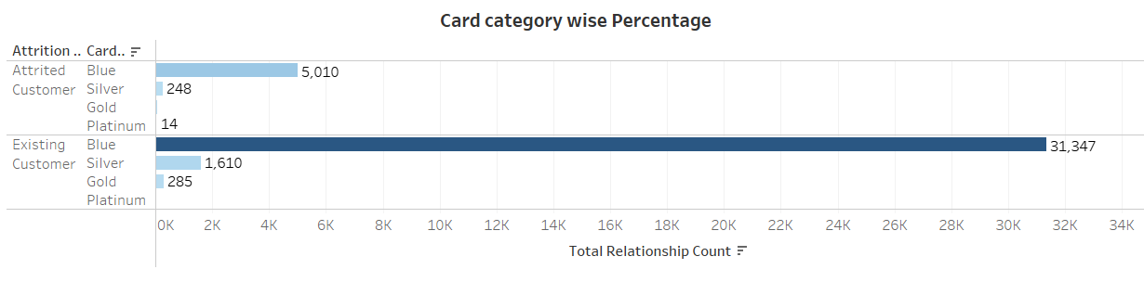
TASK-4: DISPLAY THE PERCENTAGE OF ATTIRED CUSTOMER AND EXISTING CUSTOMER FROM THE DATA FOR EACH CARD CATEGORY.
INTERPRETATION: Blue card holder customer is showing the highest number of existing customers and Platinum card holder number is the least.

Slide 11
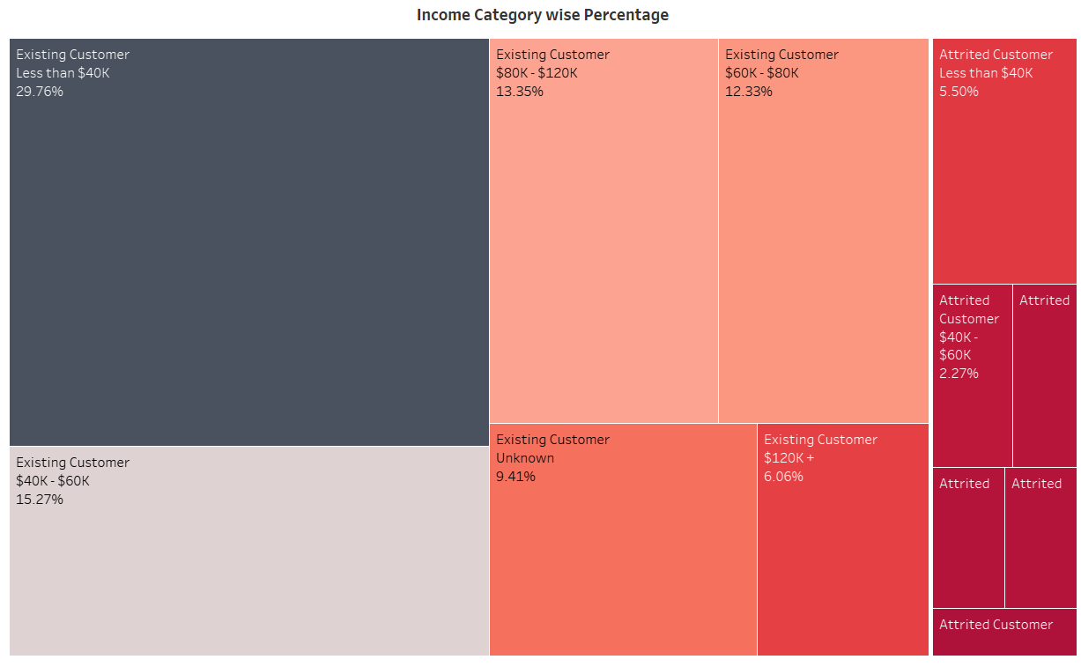
TASK-5 : DISPLAY THE PERCENTAGE OF ATTIRED CUSTOMER AND EXISTING CUSTOMER FROM THE DATA FOR EACH INCOME CATEGORY.
INTERPRETATION: Existing customers, who are coming in category of income less than $40k are showing the highest percentage and after that income category lies between $40k-$60k at second higher place.

Slide 12
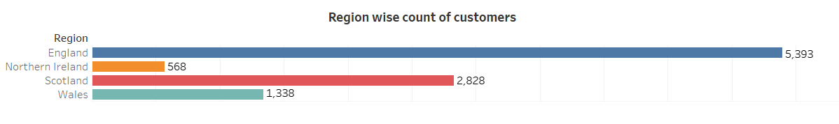
TASK-6: DISPLAY THE REGION WISE COUNT OF CUSTOMERS.IDENTIFY THE REGION THAT HAS MAXIMUM NUMBER OF CUSTOMERS.
INTERPRETATION: Here we have display the region wise count of customers. England has the maximum number of customers.

Slide 13
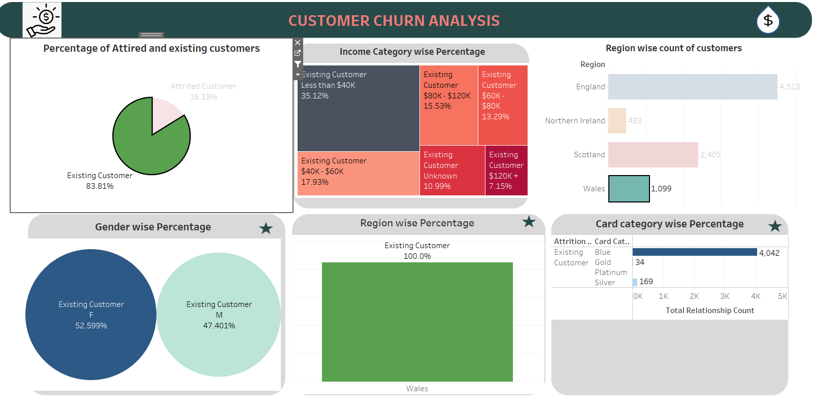
TASK-7: DISPLAY THE VISUALS THROUGH AN INTERACTIVE DASHBOARD BY ADDING ACTION FILTER .

Slide 14
summary:
From the Analysis ,we can conclude the following points:
Only 14% customers are thinking about to churn ,84% are having good relationship with the Bank.
During Gender wise analysis, it has found that more Females customers are thinking about to churn as compared to Male customers.
England is the region from which higher customers are churning as well as existing also.
‘Blue’ card holding customers are more churning as compared to others card holders.
Customers who are coming under category ‘less than $40k’ are churning with high percentage as compared to other income category.
So keeping all the above discussed points in our mind, we can minimize the rate of churning the customers from Bank and even a healthy and strong relationship can be created between customers and Bank.

Slide 15
Recommendations:
By implementing these recommendations, the bank can minimize churn rates, strengthen customer loyalty, and foster a healthier relationship with its customers:
Targeted Retention Strategies: While only 14% of customers are considering churning, it's essential to implement targeted retention strategies to address their concerns and keep them engaged. This could involve personalized offers, proactive communication, and dedicated support to address their needs.
Gender-Specific Engagement: Given that more female customers are considering churning compared to male customers, it's important to understand the unique needs and preferences of each gender segment. Tailoring marketing and communication strategies to resonate with female customers could help improve retention rates.
Focus on Engaging Customers from England: Since England appears to have higher churn rates compared to other regions, special attention should be given to understanding the reasons behind this trend. Engaging with customers from England through targeted campaigns, feedback surveys, and improved service offerings could help reduce churn and strengthen loyalty.
Address Concerns of 'Blue' Cardholders: Customers holding 'Blue' cards show a higher propensity to churn. It's crucial to investigate the reasons behind this trend and address any pain points specific to this cardholder segment. Offering incentives, enhancing benefits, or providing better customer service to 'Blue' cardholders could help retain them.
Enhanced Customer Relationship Management (CRM): Implementing robust CRM practices can help the bank better understand customer behavior, preferences, and pain points. Leveraging data analytics and customer feedback, the bank can proactively address issues, personalize offerings, and foster stronger relationships with customers.

Slide 16
THANK YOU

